Slide 1

FACTORY RECOMMENDATION FOR HALDON
BY ZHAO MING SOH

Slide 2

Phase 1: Framing
Step 1: Defining the context :
Recommend a car manufacturing factory in one of these 3 countries, Australia, Canada and Indonesia for Haldon.
Step 2: Objective Setting :
Identify Values.
Set the Objectives.
Identify the attribute scale for each of the objective.
Measures the level of achievement of each objective.

Slide 3
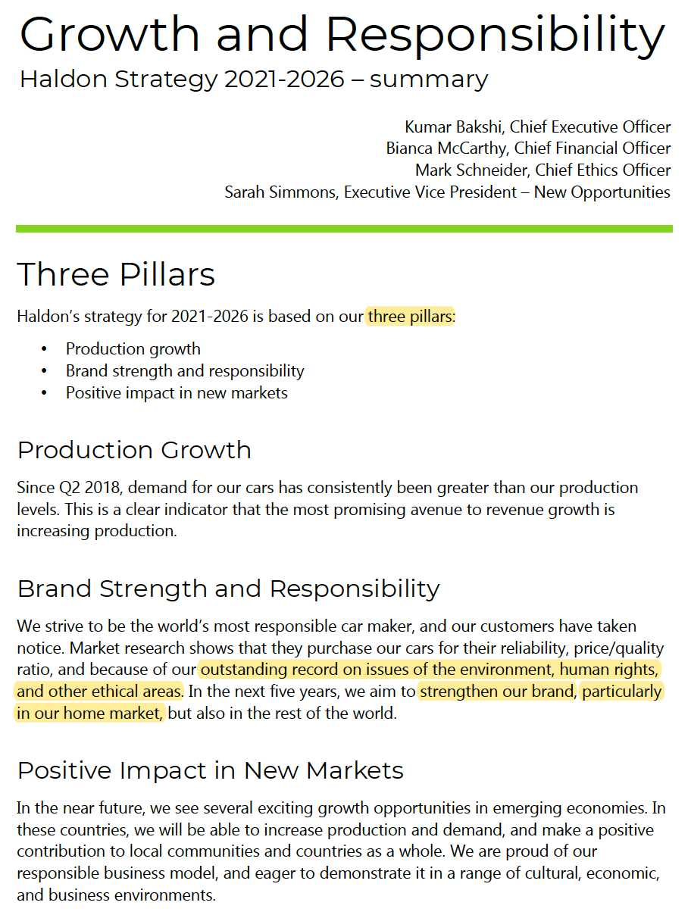
Objective Setting – Identifying Values

Slide 4





Set the Objectives
Net Present Value, (NPV)
Environment Impact
Demand
Worker’s Quality of Life
Reliability/Quality

Slide 5
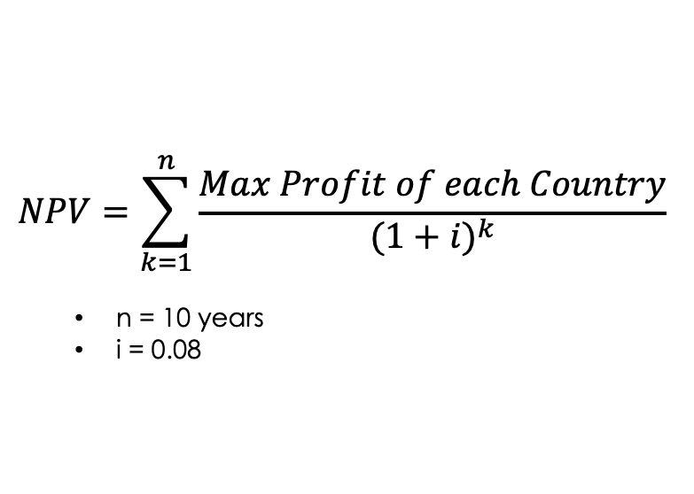
Net Present Value, NPV
$$NPV=\sum_{k=1}^{n}{\frac{Max Profit of each Country}{{(1+i)}^{k}}}$$
n = 10 years
i = 0.08
What is NPV ?
It a financial ratio used to find the present-day value of a future stream of cashflows. (Profitability of investments)
Positive = Profitable
Negative = Not Profitable
How do we Calculate it for each country?
Use the max profit of each country to calculate their corresponding NPV.

Slide 6
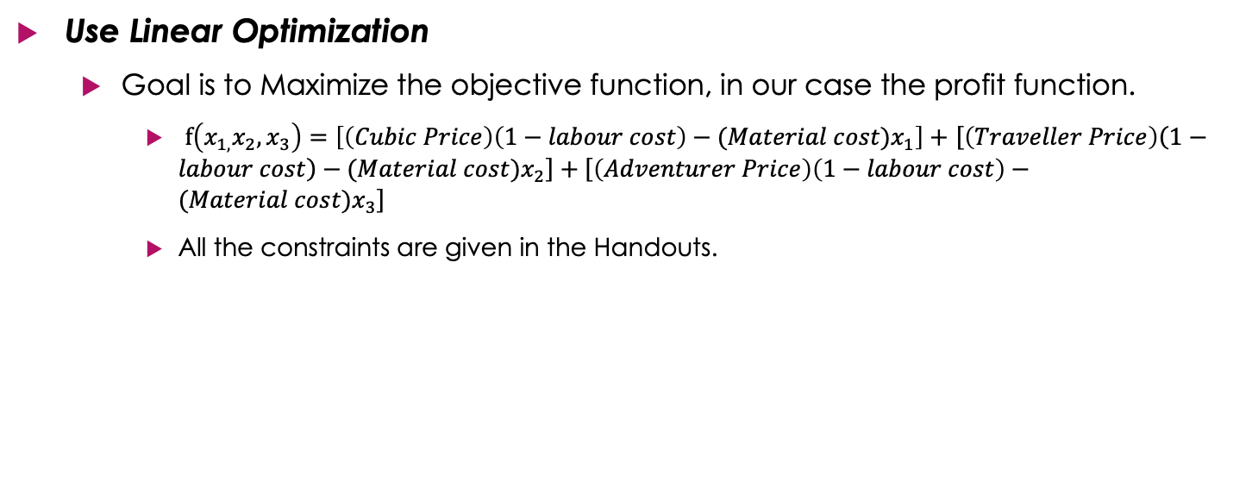
Max Profit of each Country
Use Linear Optimization
Goal is to Maximize the objective function, in our case the profit function.
$f\left(x_{1,}x_{2},x_{3}\right)=\left[\left(Cubic Price\right)\left(1−labour cost\right)−(Material cost)x_{1}\right]+$ $\left[\left(Traveller Price\right)\left(1−labour cost\right)−(Material cost)x_{2}\right]+\left[\left(Adventurer Price\right)\left(1−labour cost\right)−(Material cost)x_{3}\right]$
All the constraints are given in the Handouts.

Slide 7
Demand
Why?
It is a good indicator of how well desired a particular product is in a country.

Slide 8
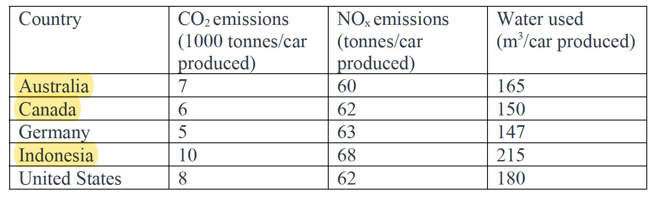
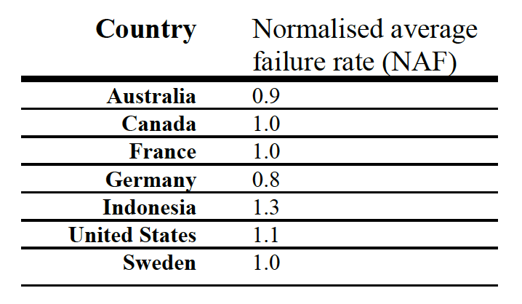
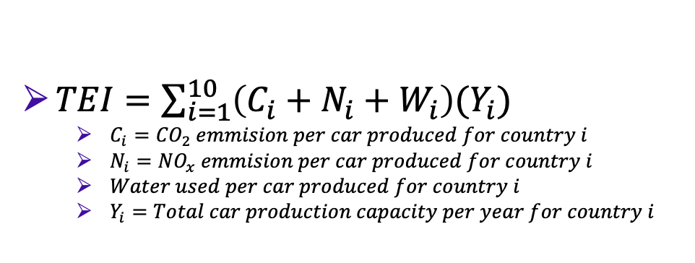
Environment Impact & Reliability/Quality
$TEI=\sum_{i=1}^{10}{\left(C_{i}+N_{i}+W_{i}\right)(Y_{i}})$
$C_{i}={CO}_{2} emmision per car produced for country i$
$N_{i}={NO}_{x} emmision per car produced for country i$
$Water used per car produced for country i$
$Y_{i}=Total car production capacity per year for country i$

Slide 9
Phase 2: Modelling
Construct the Model : Payoff Matrix
Quantifies how well each country scores on the objective attribute scales.
2 Important steps:
Convert all the objectives scores on each country to a common a value.
Apply the weights for each of the objective to reflect on their importance in choosing between the different countries.

Slide 10
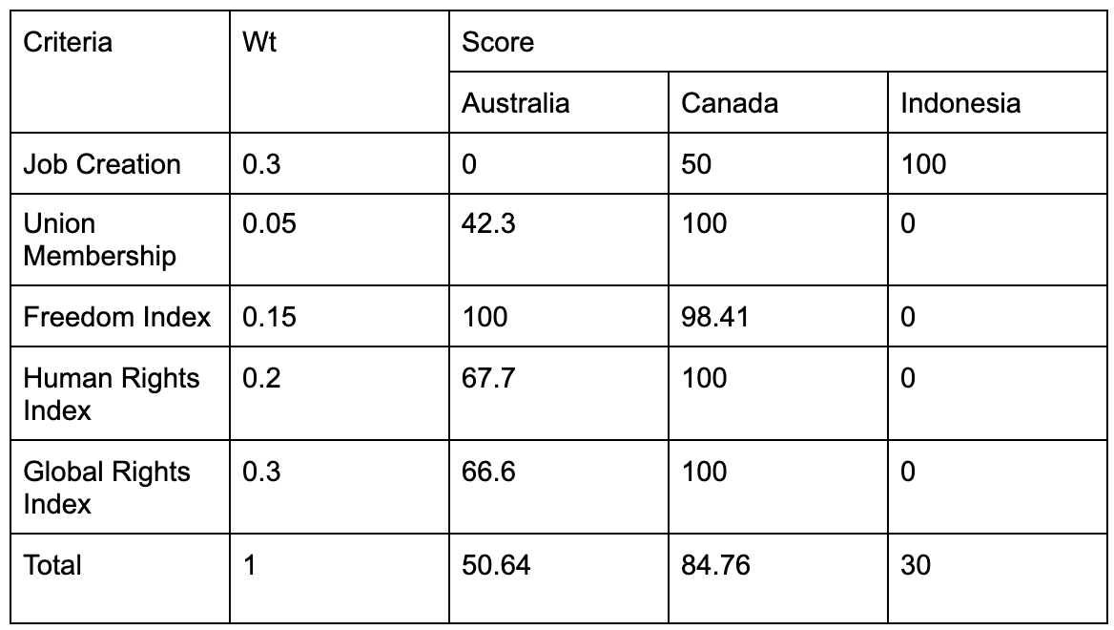
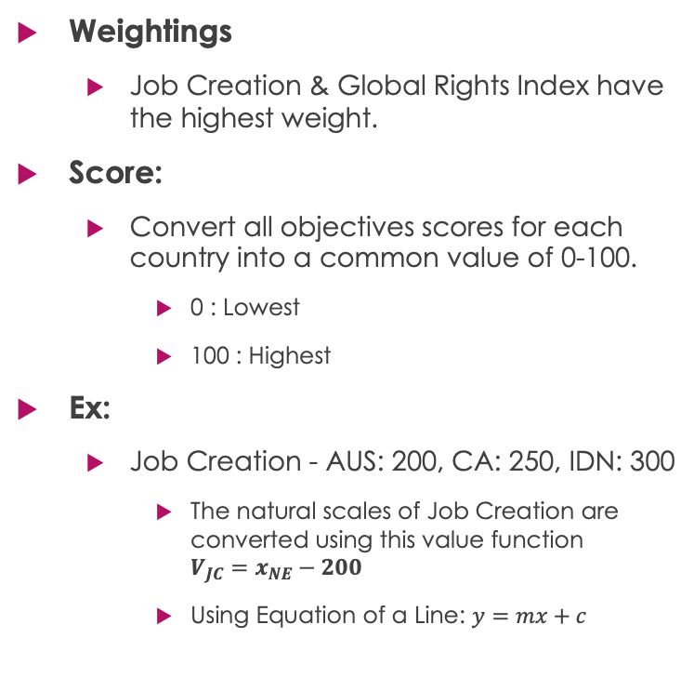
Worker’s Quality of Life
Weightings
Job Creation & Global Rights Index have the highest weight.
Score:
Convert all objectives scores for each country into a common value of 0-100.
0 : Lowest
100 : Highest
Ex:
Job Creation - AUS: 200, CA: 250, IDN: 300
The natural scales of Job Creation are converted using this value function $V_{JC}=x_{NE}−200$
Using Equation of a Line: $y=mx+c$

Slide 11
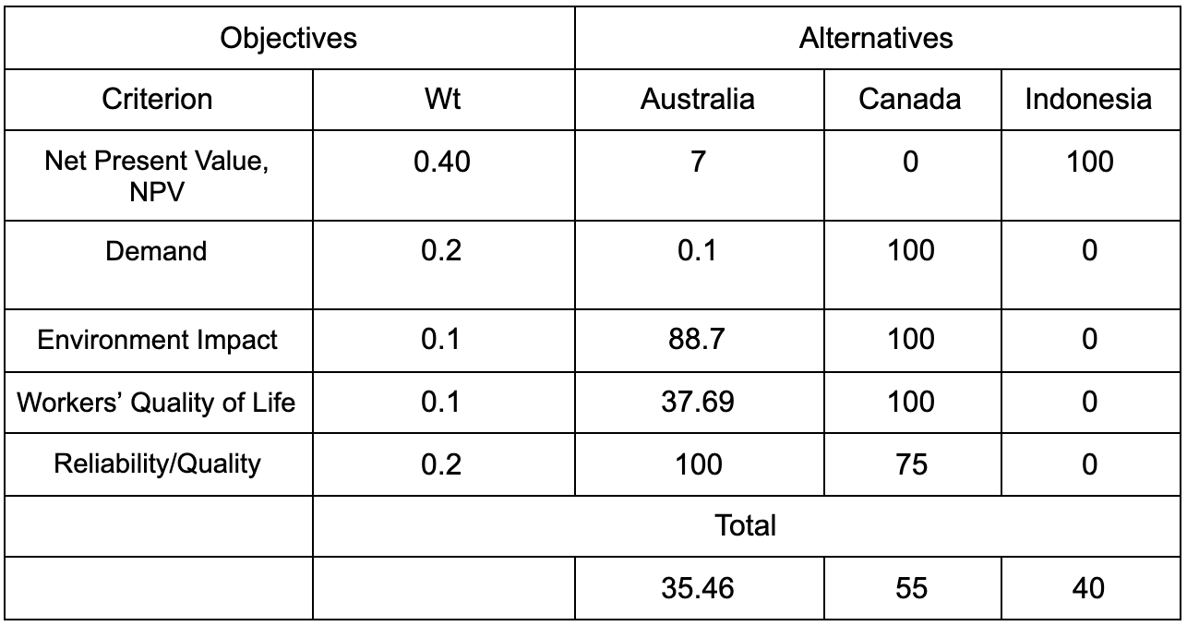
Final Payoff Matrix

